Slide 1
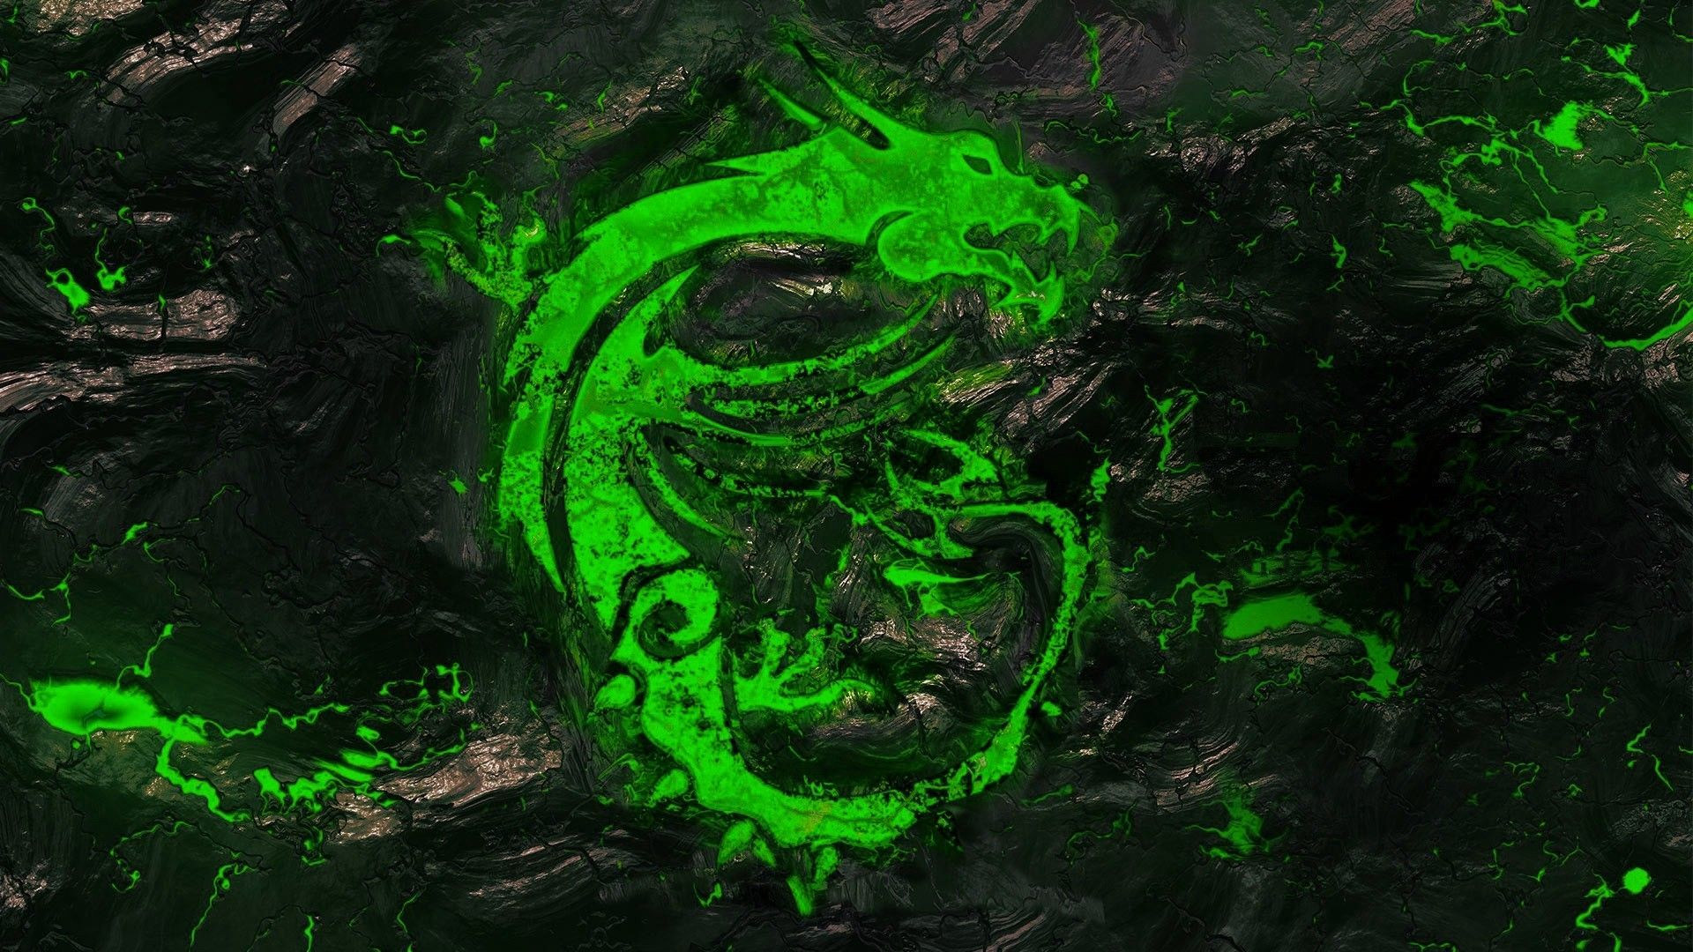
GAMECENTRAL APP 🎮
We intend to create an app for all the gamers across the
community of all platforms to come together on a station and
share their experiences and views.
Our app will provide:
User Profiles
Friends List
Chat and Messaging
Groups and Clans
Leaderboard
Game Ratings and Reviews
Gaming News
Push Notifications
Gameplay Guide
Subscription Models
Tournaments with prizes
Live Events
Live Streaming through app
Community and forums
Legal and privacy compliance
Record gameplay through app
Feedback and support
We will create an app using C++ and Java Script where IDE will provide good platform.
Canva is used to design user interface.
Below provided is a prototype like UI interface of our app created by us.
We will be aiming to make this app for IOS, Android , Windows and for Mac as well

Slide 2

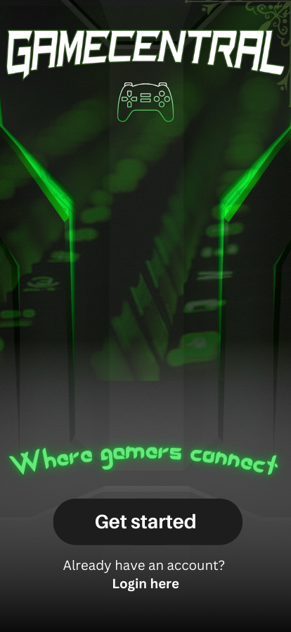
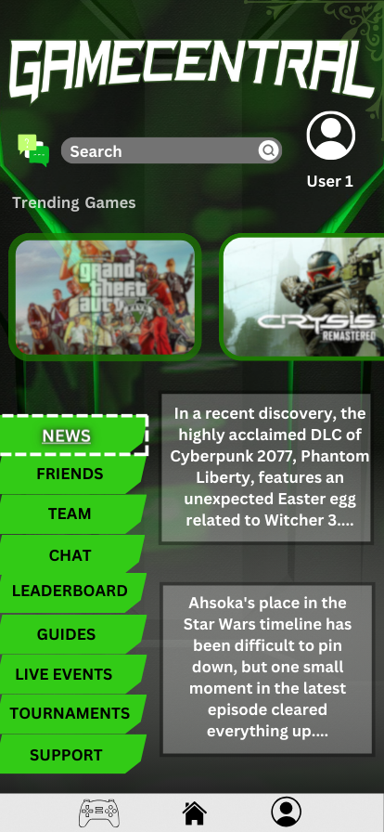

Slide 3

Usage of AI in Game Development 🤖
In today’s world , we can introduce AI in
games so that we can save our time for
tasks which can be easily performed by
Artificial Intelligence for us.
We intend to create a prototype which would work as an interface between user and AI. When a user wants to build a palace/castle in Minecraft, it takes a lot of time for him to build it block by block.
Here, we will make a command system which would contain catalogue for plenty of structures which can be chosen by user from the list and the bot(AI) will build the exact building for the user. This will save time of user with the help of AI.
A software which would connect the user and application.

Slide 4
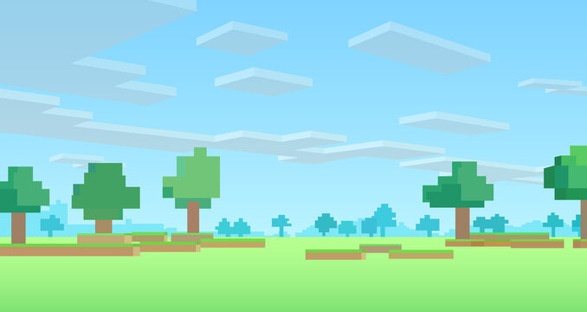
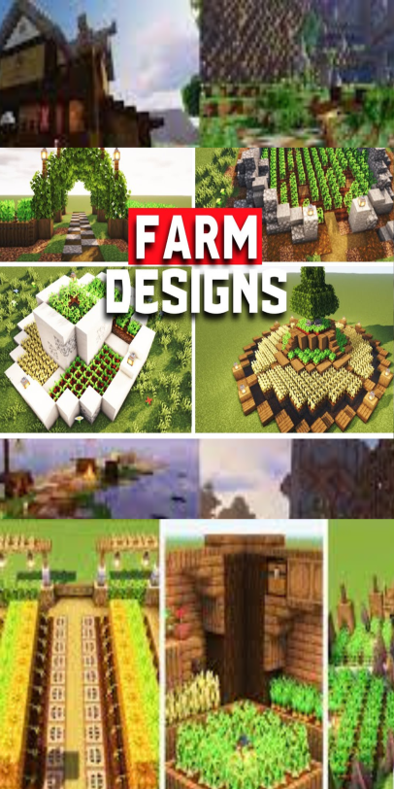
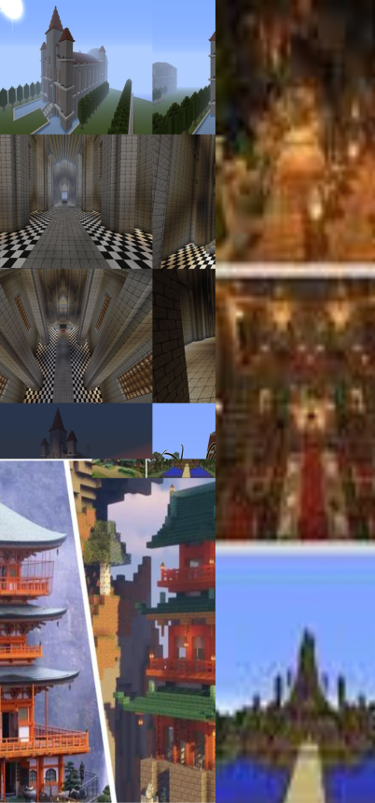
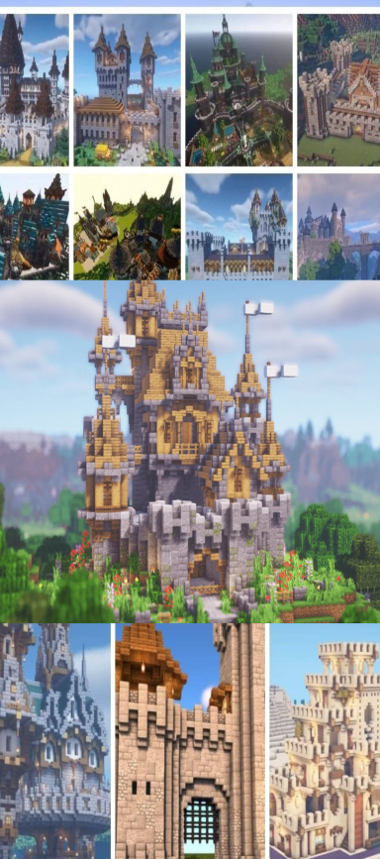
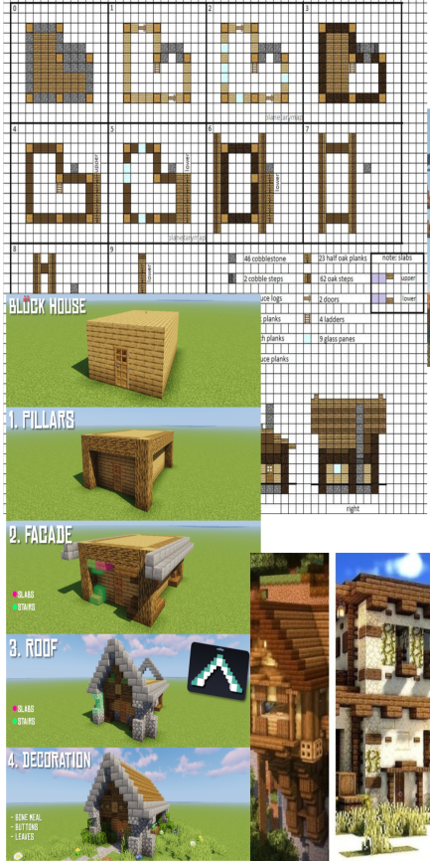
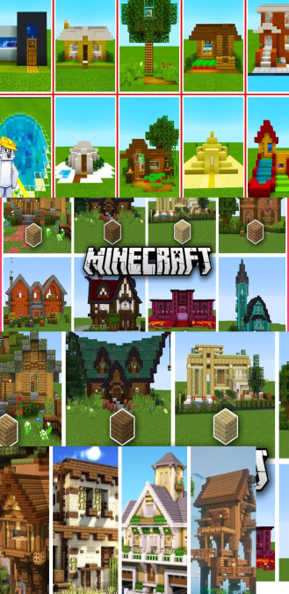
Input for selecting types of structures:
Eg: Range(a,e)
User can select the structure
CATALOGUE
STRUCTURES
a
b
c
d
e
HOUSE
FARM
TEMPLE
CASTLE
HUT
EG: {
Input-[1,40] ranging all houses }

Slide 5
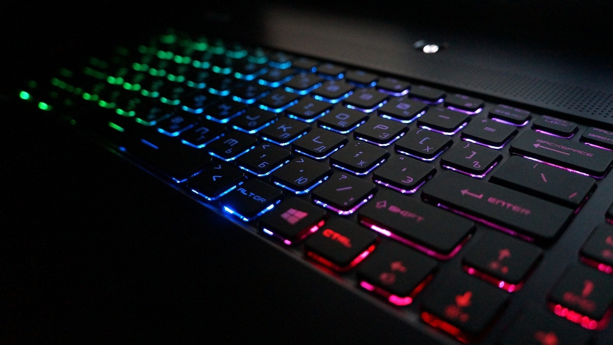
USE OF MACRO FOR BETTER USER EXPIRIENCE…
Macros are typically snippets of code that can be expanded into larger code blocks
or perform specific actions with a single command which in further saves time of
Developer.
We intend to make a web application with which developers and gamers both can be
benefitted.
We are creating a macro software with which game developers(while using blender)
can use macro to execute repetitive actions numerous no of times by assigning a
hotkey and giving the input for the desired output.
For eg: (a game developer will be able to mount numerous no. of objects by pressing just 1 hotkey which he/her has assigned).
The software will also help the coders

